Slide 1

Agile Software Development
CH02: SCRUM & KANBAN
Course Instructor: AMIR IMAM

Slide 2
SCRUM
Scrum is an agile project management framework that helps teams structure and manage their work through a set of values, principles, and practices.
Scrum is a lightweight framework that helps people, teams and organizations generate value through adaptive solutions for complex problems.

Slide 3
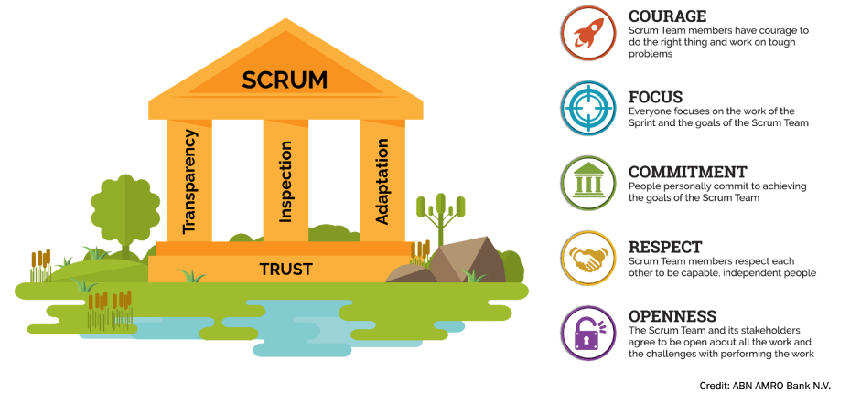
SCRUM
Scrum has three pillars: Transparency, Inspection & Adaptation.
The Scrum Values of Courage, Focus, Commitment, Respect, and Openness, are all important elements
Trust is the characteristic that binds all of the elements together

Slide 4
THE SCRUM FRAMEWORK

Slide 5
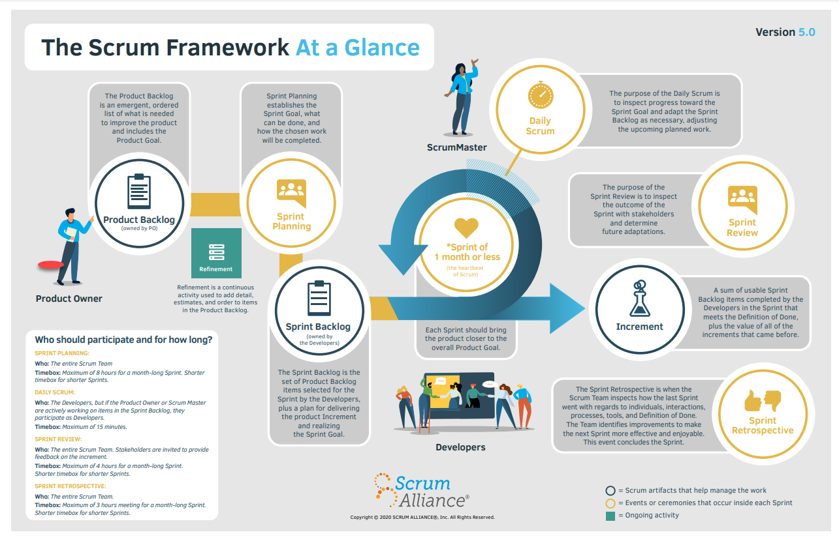

Slide 6
SCRUM Framework
03 Roles
05 Events
03 Artifacts
06 Principles
Product Owner
Scrum Master
Development Team
Sprint
Sprint Planning
Daily Scrum
Sprint Review
Sprint Retrospective
Product Backlog
Sprint Backlog
Product Increments
Empirical Process Control
Self-Organization
Collaboration
Value Based Prioritization
Time Boxing
Iterative Development

Slide 7
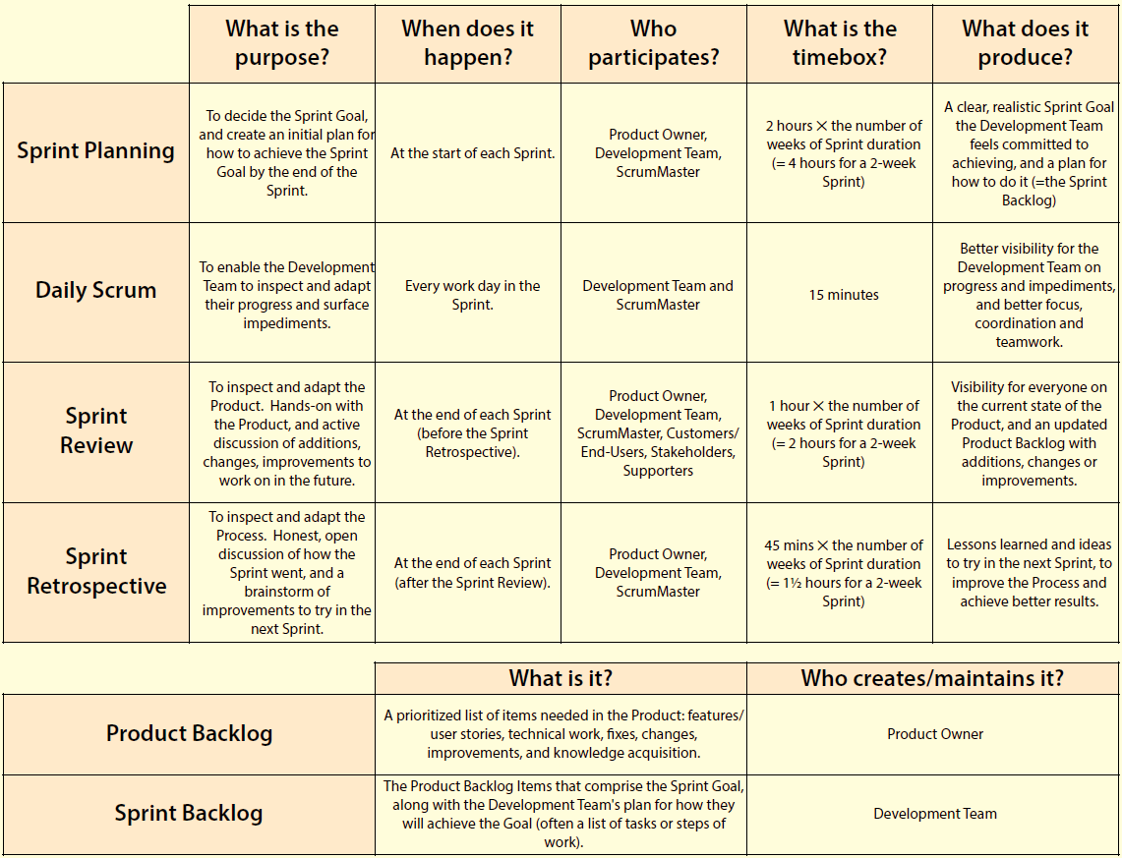

Slide 8
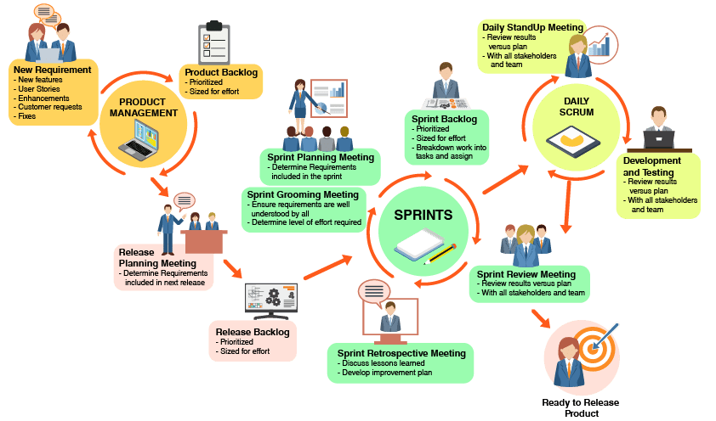

Slide 9
Scrum Roles

Slide 10
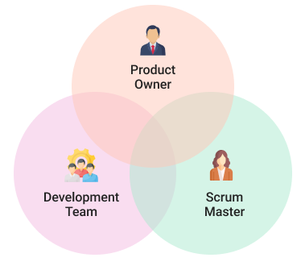
The SCRUM Team
Holds the vision for the product and prioritizes the product backlog
On a scrum team, a developer is anyone on the team that is delivering work, including those team members outside of software development
Helps the team best use scrum to build the product
Notes:
Developers - On a scrum team, a developer is anyone on the team that is delivering work, including those team members outside of software development. In fact, the 15th State of Agile Report found that the number of non-software teams adopting agile frameworks like scrum doubled from 2020 to 2021, with 27% reporting agile use in marketing, and between 10-16% reporting use in security, sales, finance, human resources, and more.

Slide 11
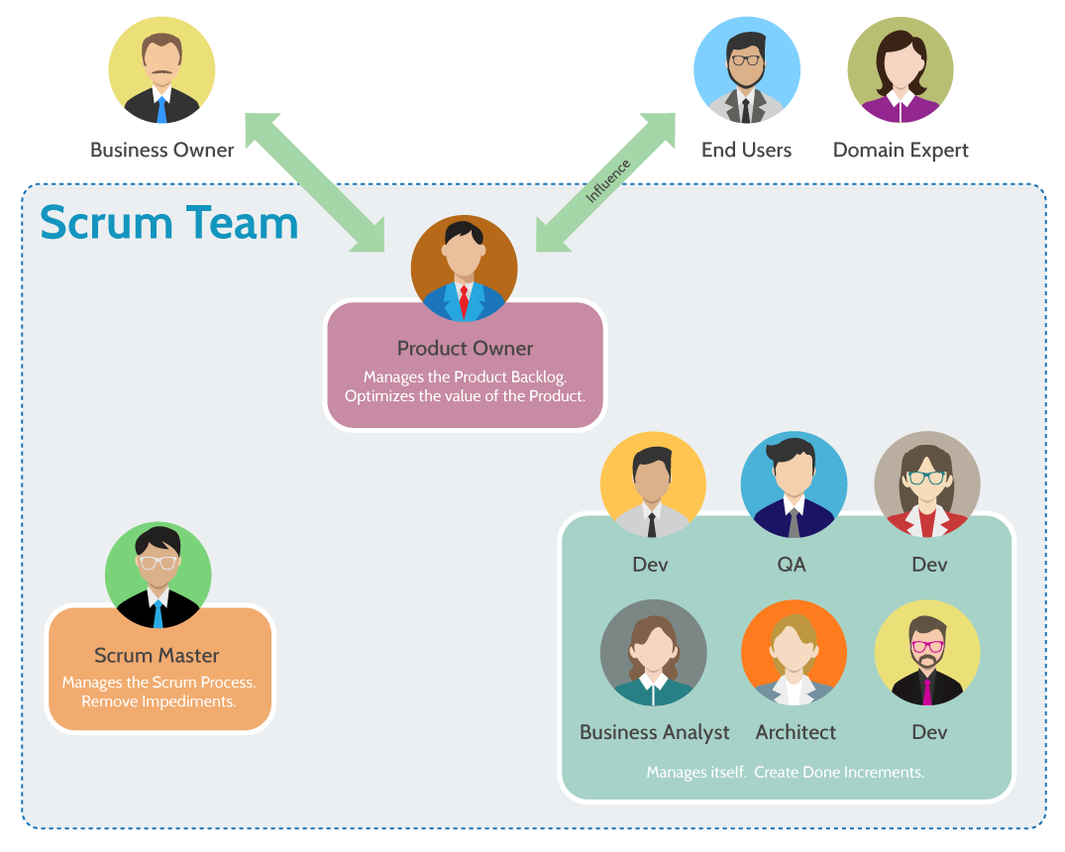

Slide 12
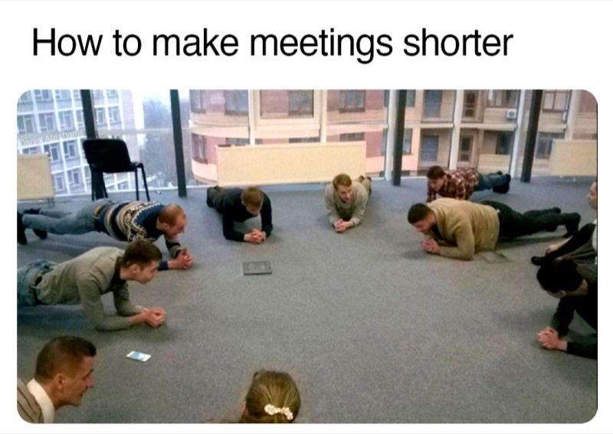

Slide 13
ACTIVITY ?
Details:
To create a picturesque landscape that includes mountains, water streams, house(s), trees, the sun, clouds, eagles, etc. Use simple and creative representations to convey the elements of the scene without getting into too much detail.

Slide 14


Slide 15


Slide 16


Slide 17





































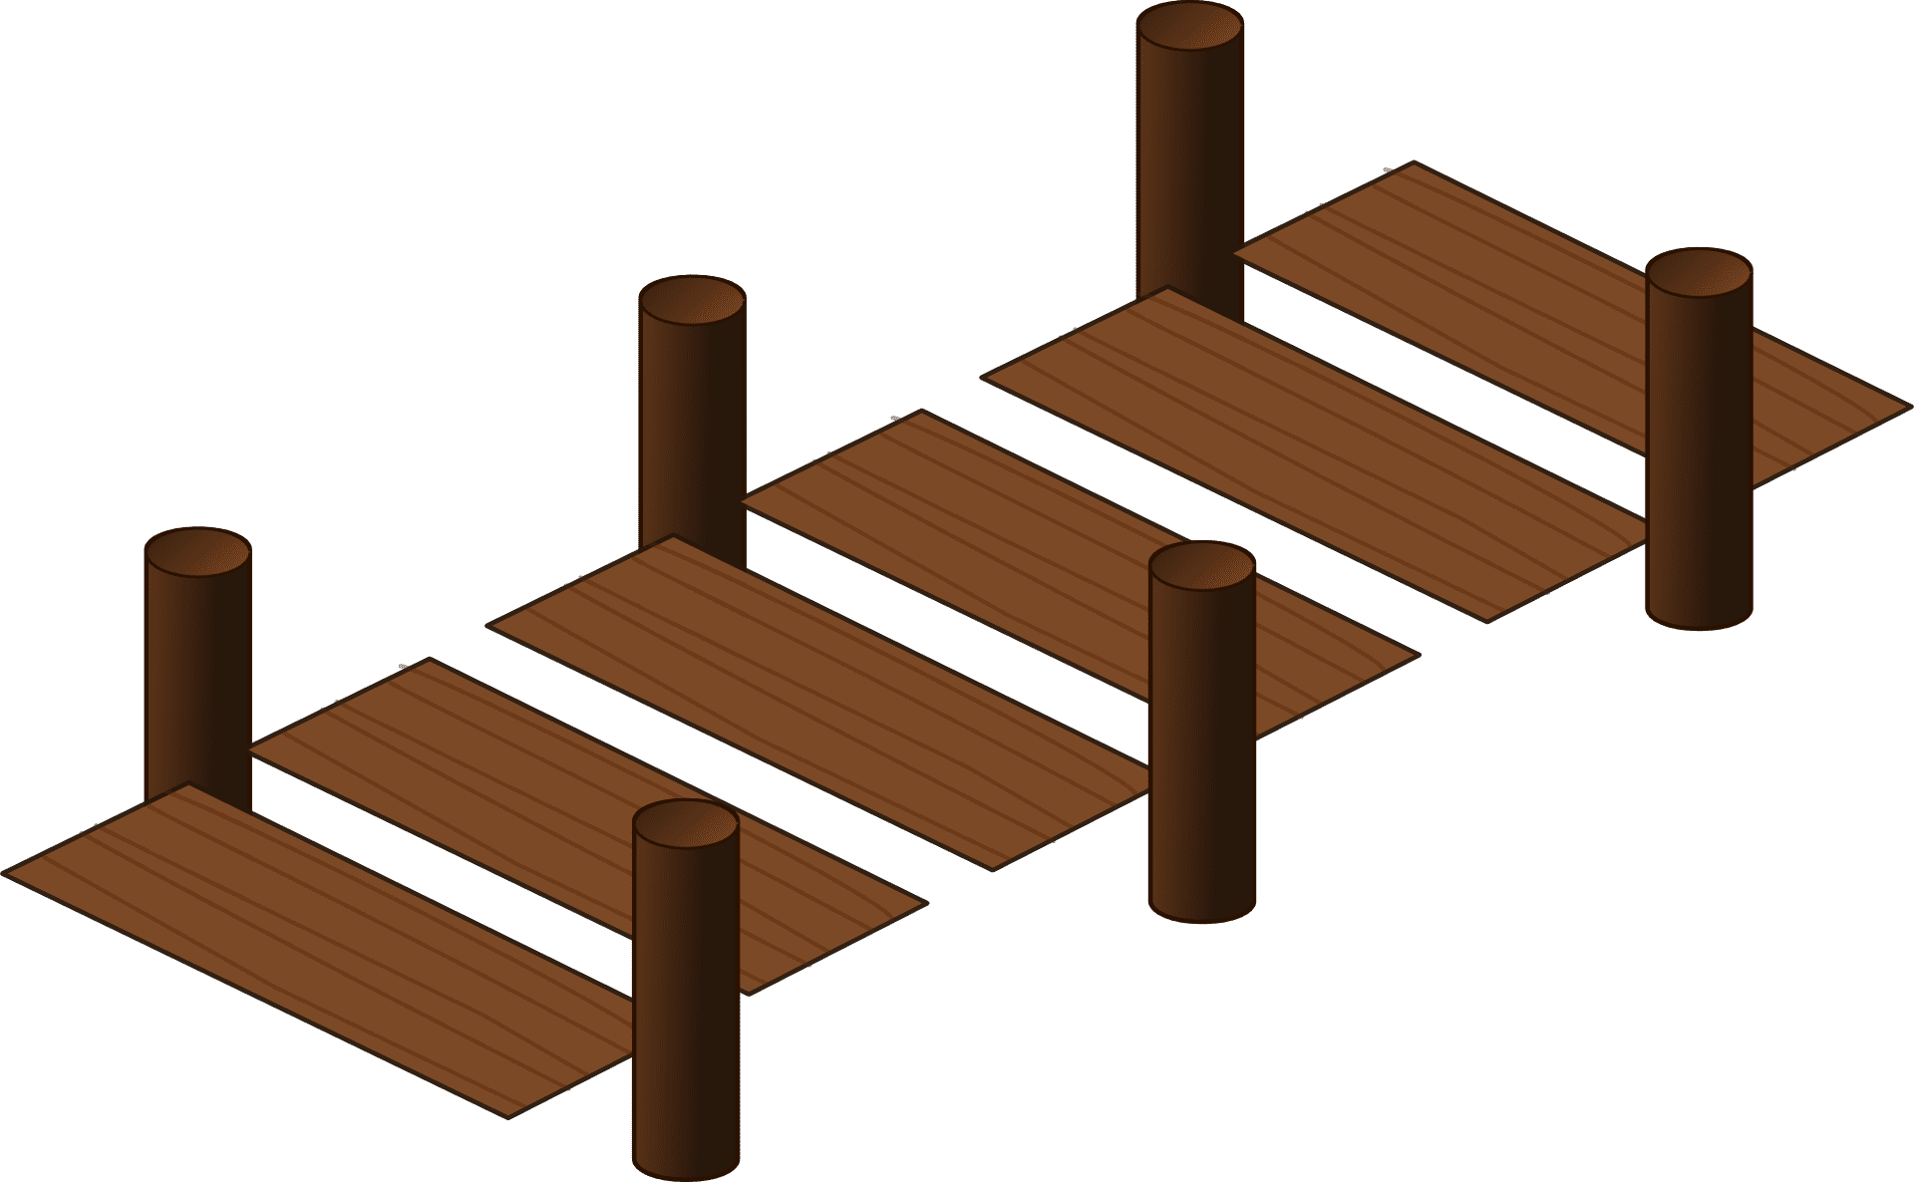



























Slide 18


Slide 19
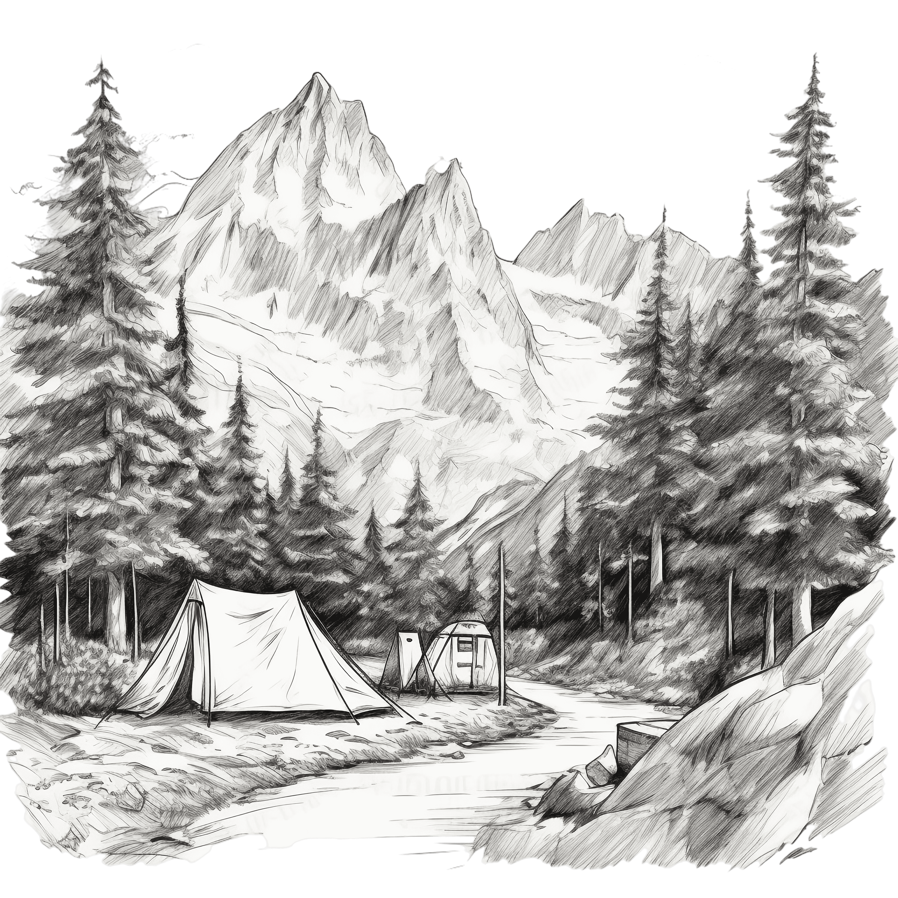








Slide 20
Activity: Scrum Roles
Title: "Agile Transformation at XYZ Tech: Navigating Scrum Roles and Responsibilities"
Introduction: In this case study, we will explore the journey of XYZ Tech, a mid-sized software development company, as they embark on an agile transformation using the Scrum framework. As part of their transformation, they are restructuring their teams and adopting Scrum roles to improve efficiency, collaboration, and product quality. Your task is to analyze the situation, identify challenges related to Scrum roles, and recommend solutions to address these challenges.
Background: XYZ Tech traditionally followed a waterfall development process, which led to delayed releases, misalignment with customer needs, and poor visibility into project progress. To address these issues, the management decided to transition to the Scrum framework. As part of this transition, they are forming cross-functional Scrum teams and implementing Scrum roles.
Scrum Roles at XYZ Tech:
Product Owner (PO): Sarah
Responsible for defining and prioritizing the product backlog.
Ensures that the team works on the most valuable features for the business.
Acts as a bridge between stakeholders and the development team.
Scrum Master: Alex
Facilitates Scrum events (Sprint planning, Daily Scrum, Sprint Review, Sprint Retrospective).
Removes obstacles and ensures the team adheres to Scrum principles.
Guides the team in continuous improvement and self-organization.
Development Team: Cross-functional members
Responsible for designing, developing, testing, and delivering increments of the product.
Self-organizes to determine how to best accomplish the work in the Sprint.
Collaborates closely with the Product Owner to clarify requirements.

Slide 21
Activity: Scrum Roles
Challenges Faced:
Lack of Clarity in Role Definitions: The team members are still adjusting to their new roles, and there is confusion about the specific responsibilities of each role.
Balancing Priorities: Sarah, the Product Owner, is struggling to balance stakeholder requests and expectations while maintaining a clear product backlog. There are constant changes in priorities.
Overemphasis on Authority: Alex, the Scrum Master, sometimes finds it challenging to facilitate discussions without imposing decisions on the team due to their authoritative approach.
Technical and Functional Silos: Some team members are having difficulty breaking away from their specialized areas, leading to reduced collaboration and slower progress.
Incomplete Self-Organization: The development team has yet to fully grasp the concept of self-organization, often waiting for explicit instructions rather than proactively making decisions.
Discussion Questions:
What are the core responsibilities of the Product Owner, and how can Sarah improve her backlog management and communication with stakeholders?
How can Alex, the Scrum Master, shift from an authoritative stance to a facilitative one, ensuring the team takes ownership of decisions?
What strategies can the development team adopt to overcome technical and functional silos and encourage more cross-functional collaboration?
Why is self-organization important for a Scrum team, and what benefits can XYZ Tech gain from fostering a culture of self-organization?
Suggest actionable steps XYZ Tech can take to address the challenges they are facing and improve their implementation of the Scrum framework.

Slide 22
SCRUM ARTIFACTS

Slide 23
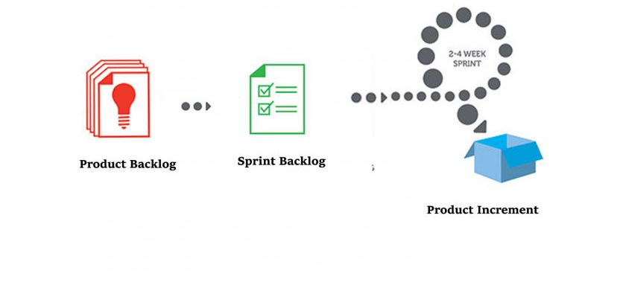
Scrum Artifacts
An emergent, ordered list of what is needed to improve the product and includes the product goal
A sum of usable sprint backlog items completed by the developers in the sprint that meets the definition of done, plus the value of all the increments that came before
The set of product backlog items selected for the sprint by the developers (team members), plus a plan for delivering the increment and realizing the sprint goal

Slide 24
Product Backlog
Who
Product Owner
Purpose
List of ordered requirements to give the development team work and direction.
When
Create at the project start.
Update continuously throughout the project.

Slide 25
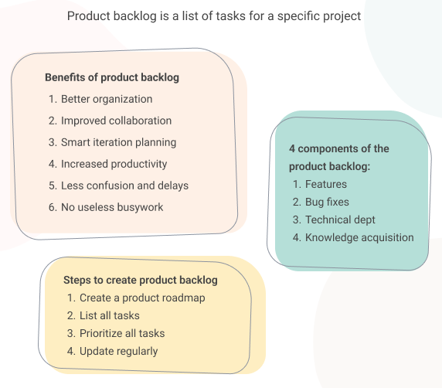
Product Backlog

Slide 26
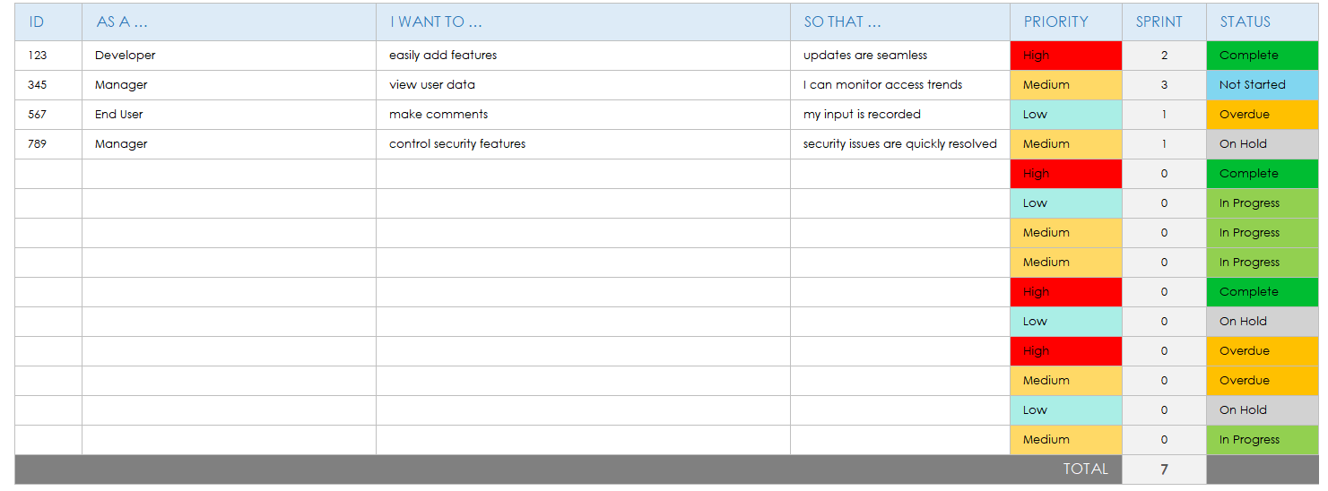
Product Backlog Example

Slide 27
Product Backlog Example
Project: Customer portal for logging technical tickets
Requirements: The portal should allow customers to log and track their tickets, it should have an admin view for the technical team who will be processing the tickets.
Example of product backlog items:
Disclaimer: Below is a simplified version of the product backlog example that shows some options of what could go into the project.
Login page for clients’ final design
Registration page for clients testing
Creating a ticket build (including attaching docs and screenshots)
Bugfix: auto-assigning of tickets to the support team leader
Test the ability to comment on tickets for the support team.
Changing ticket statuses build.
Apply text edits to the intro page.
Fix the new ticket pop-up when logging in.
Research UX best practices for customer portals.

Slide 28
Sprint Backlog
Who
Product Owner
Purpose
Select user stories the development team can complete during the sprint to meet the sprint goal.
When
At the start of each sprint.
Scrum Master
Development Team

Slide 29
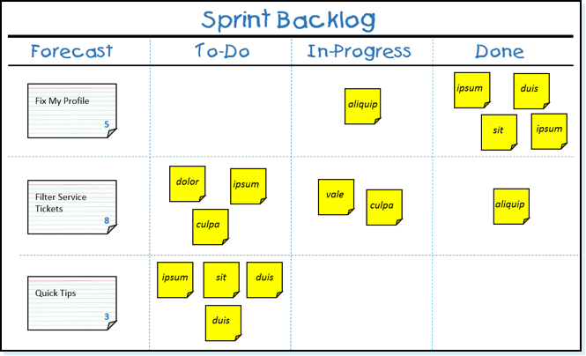
Sprint Backlog

Slide 30
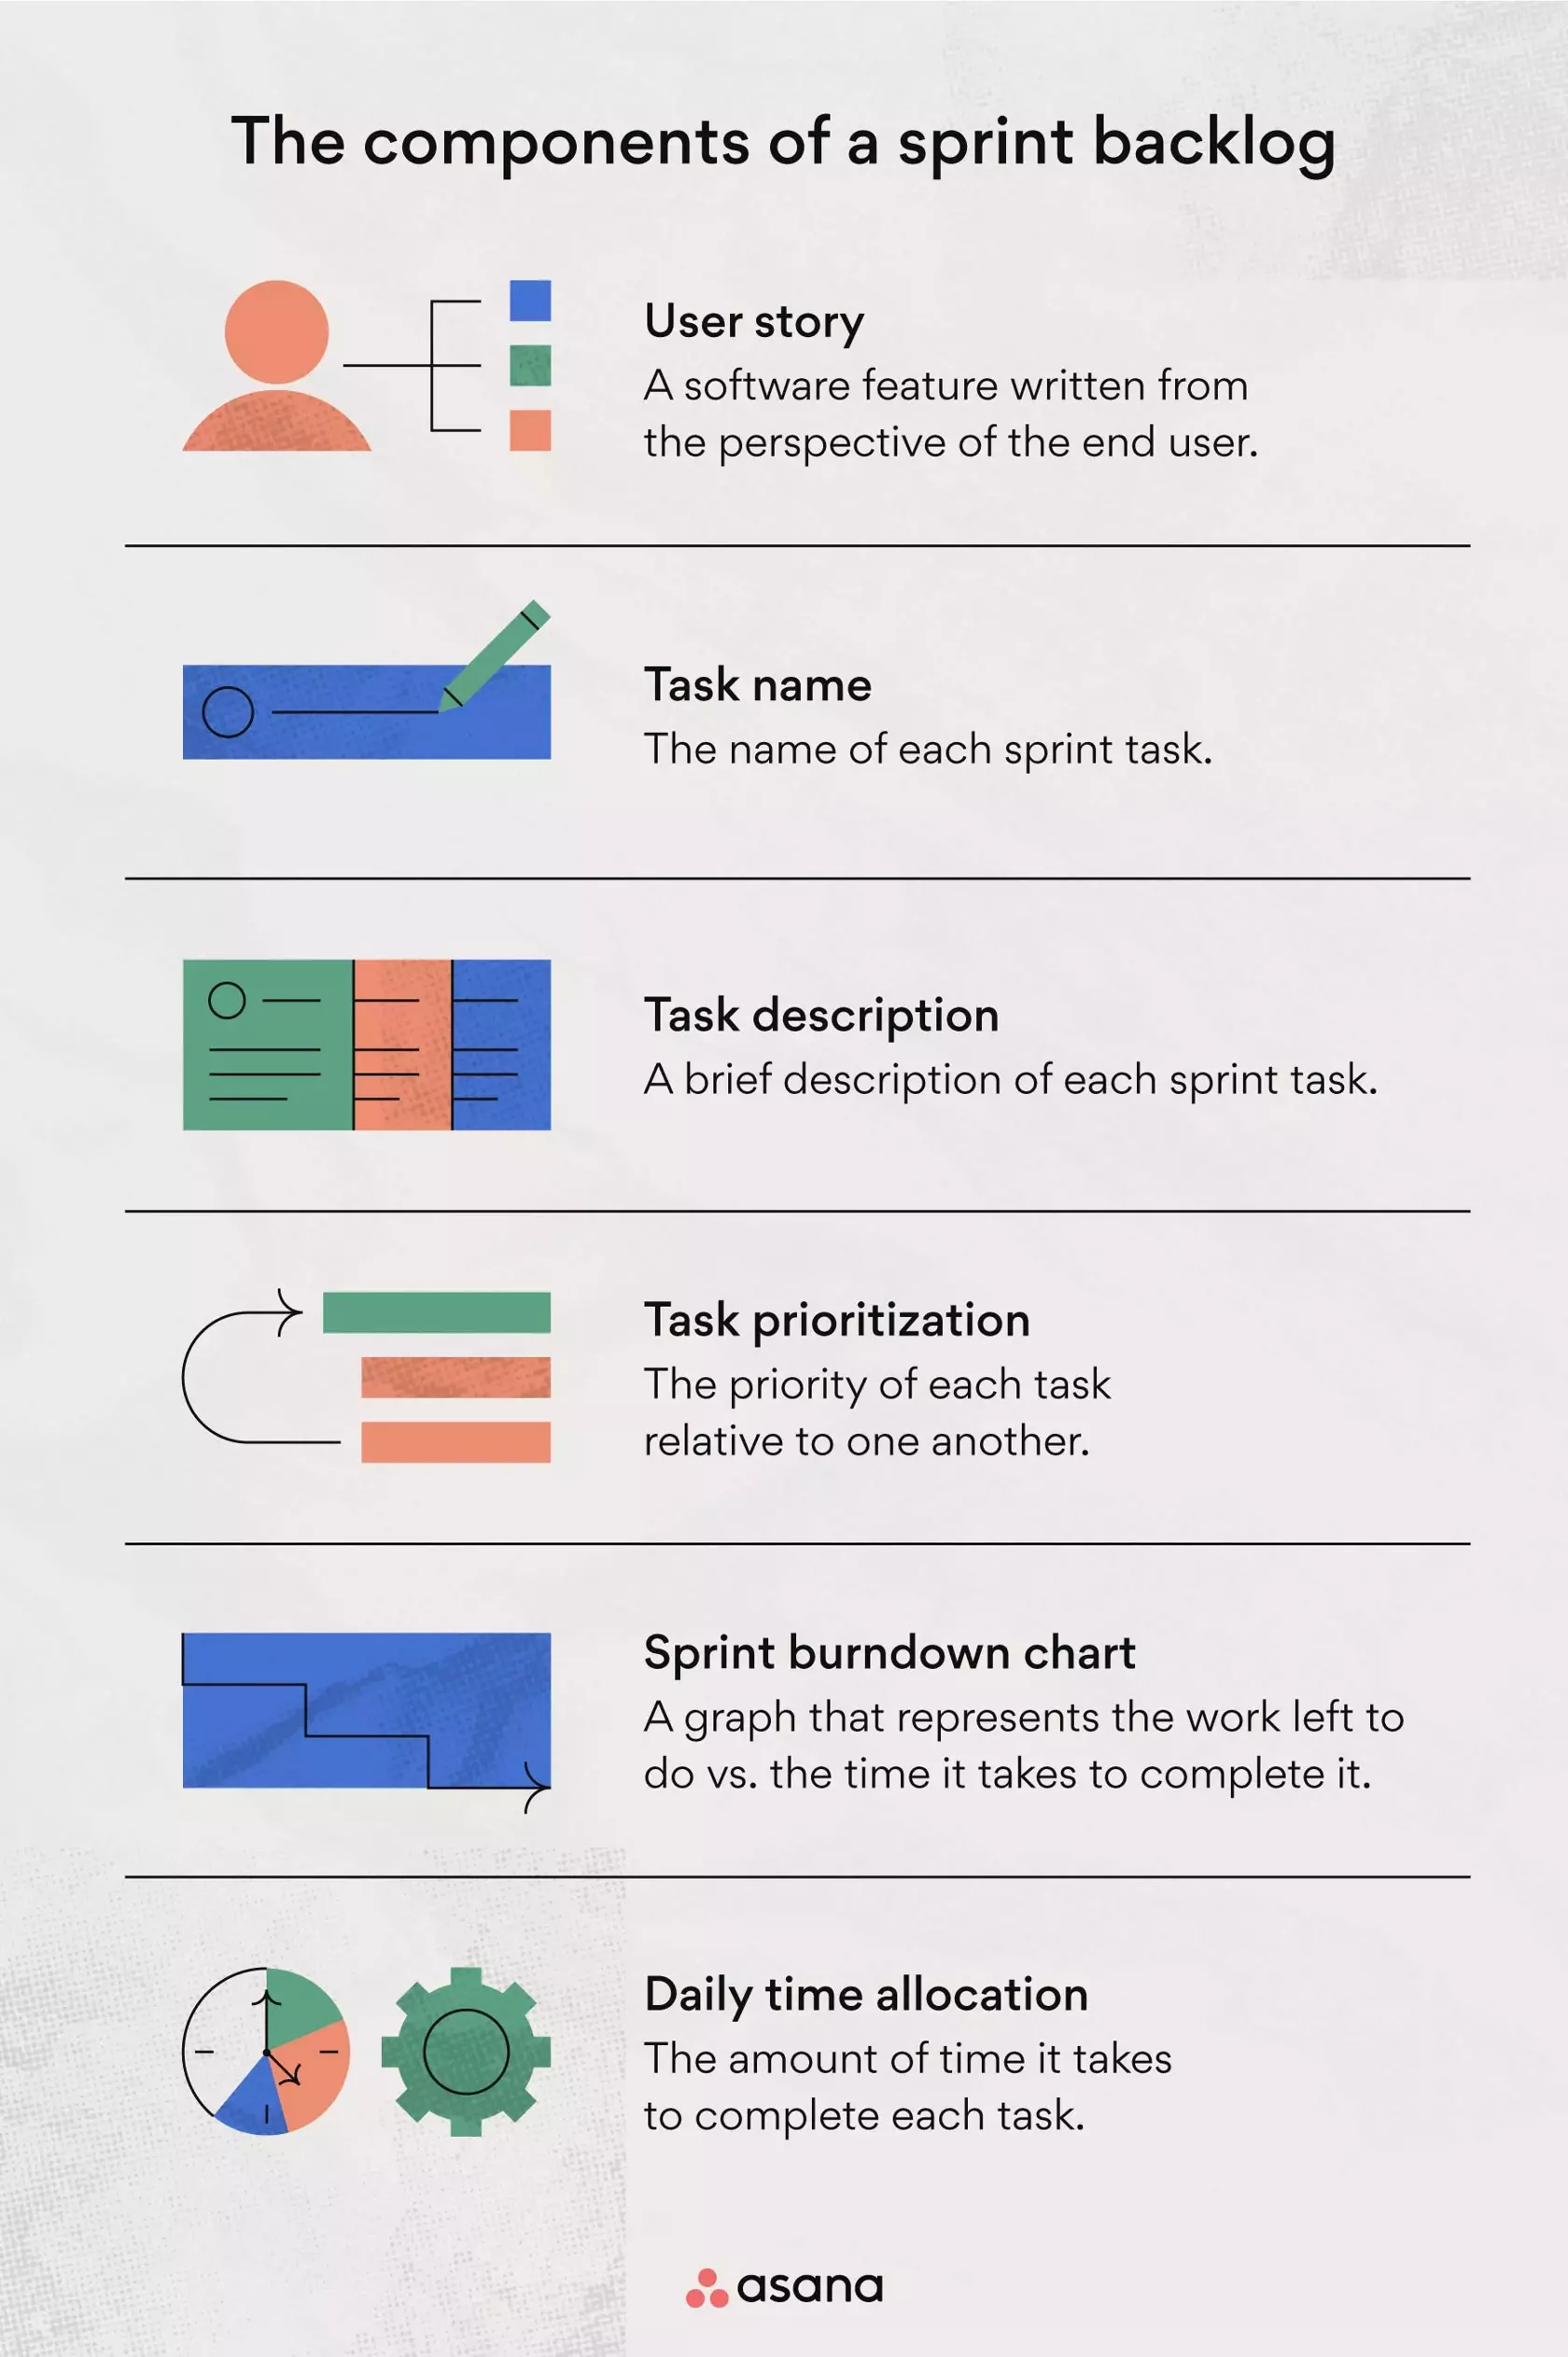
Sprint Backlog Components
Userstory
A software feature written from the perspective of the end user
Task Name
The name of each sprint task.
Task Description
A brief description of each sprint task.
Task Prioritization
The priority of each task relative to one another.
Sprint Burndown Chart
A graph that represents the work left to do vs the time it takes to complete it.
Daily Time Allocation
The amount of time it takes to complete each task.

Slide 31
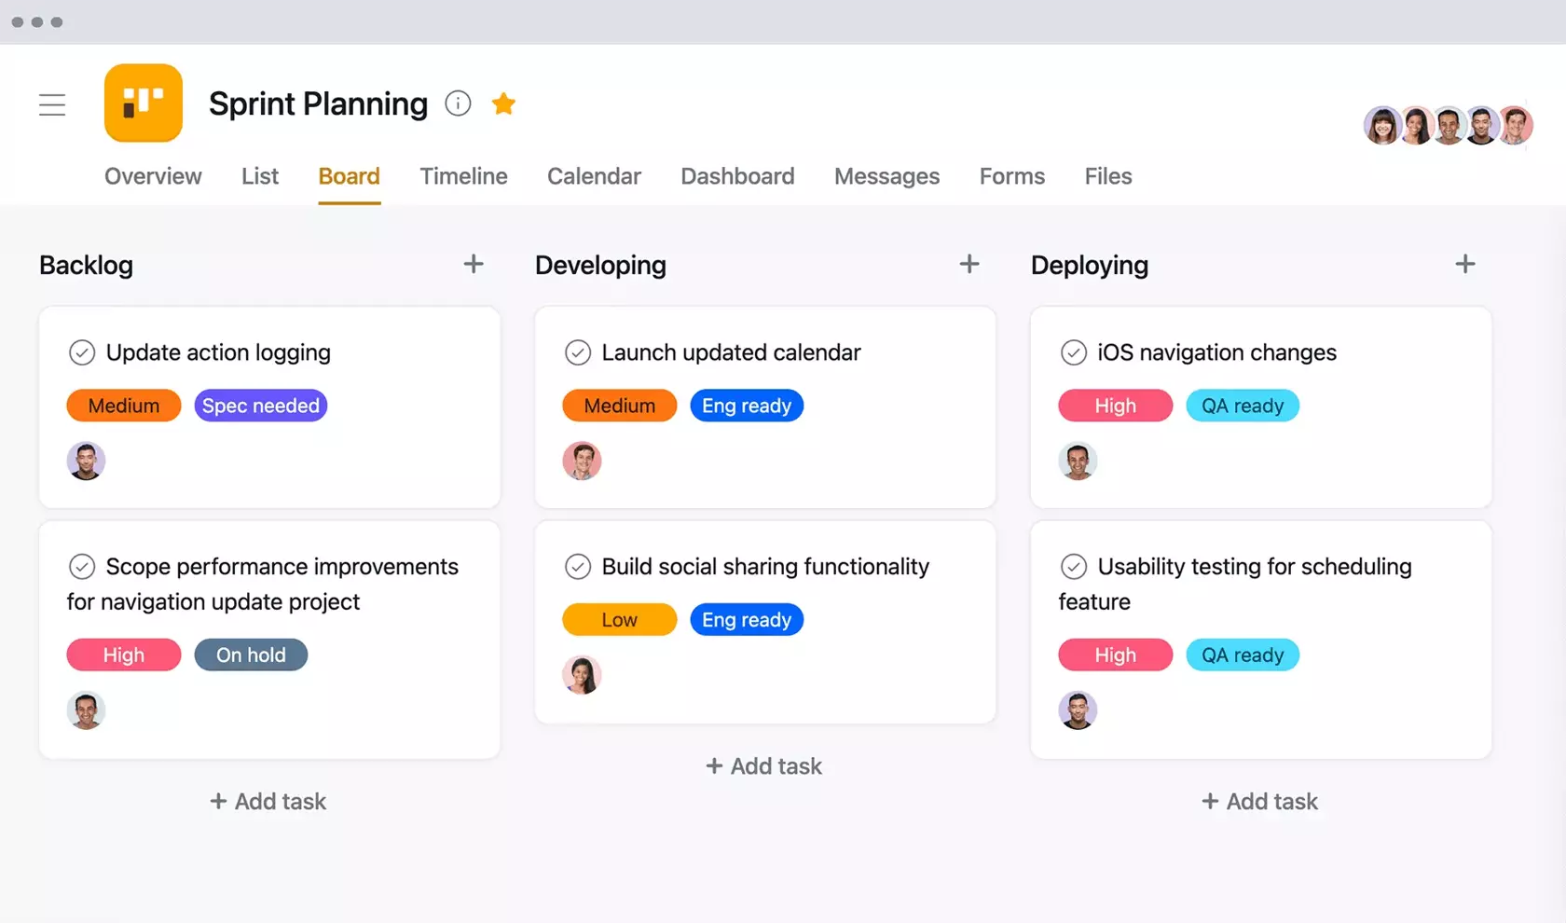
Sprint Backlog Example

Slide 32
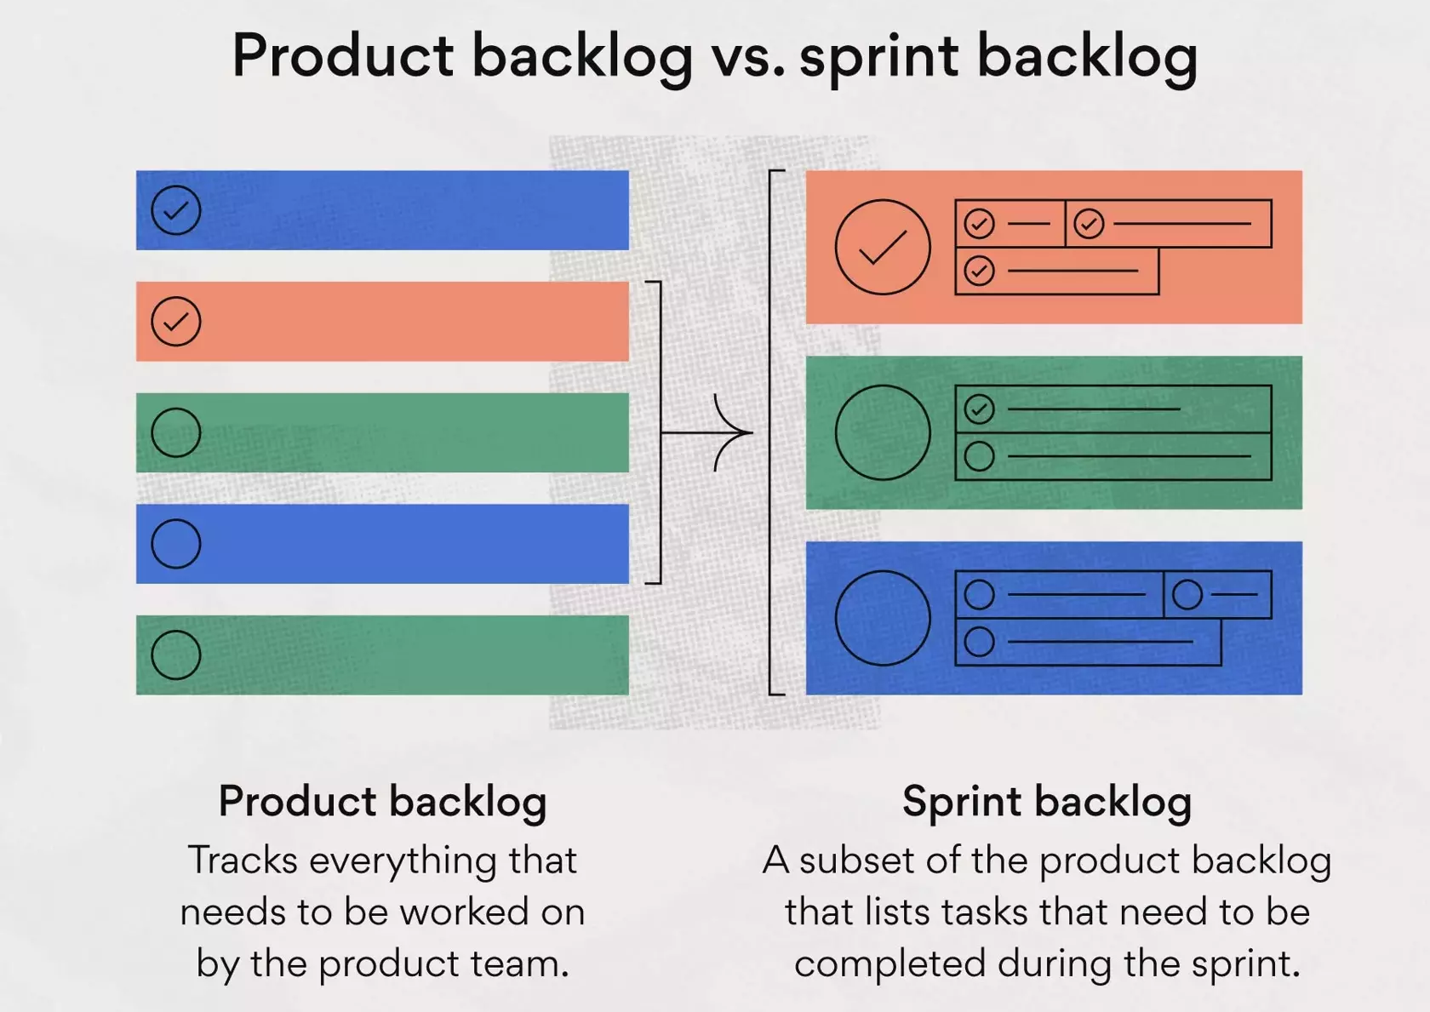
Sprint Backlog Vs Product Backlog

Slide 33
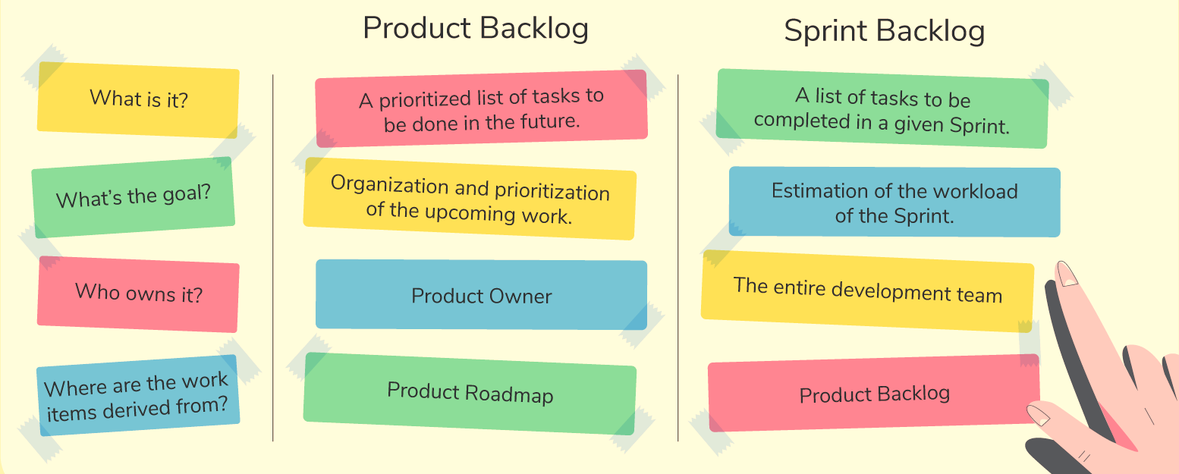
Sprint Backlog Vs Product Backlog

Slide 34
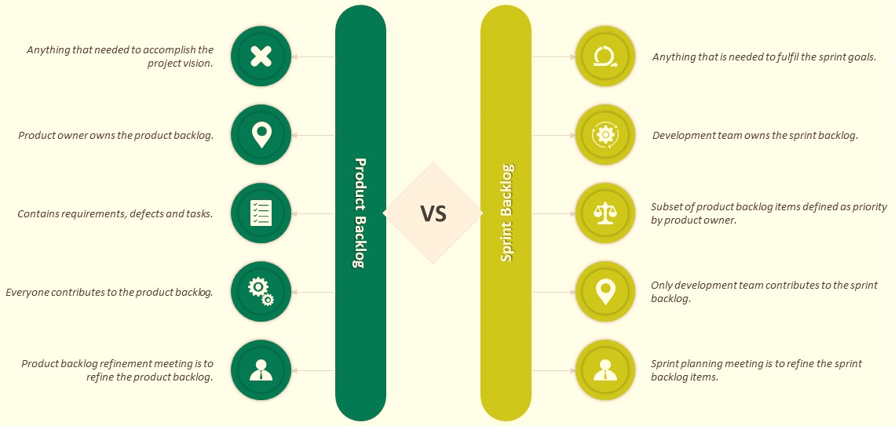
Product Backlog vs Sprint Backlog

Slide 35
Product Increment
Who
Product Owner
Purpose
To showcase progress and deliver a potentially shippable product slice to stakeholders
When
At the end of a Sprint, the new Increment must be “Done”
Scrum Team

Slide 36
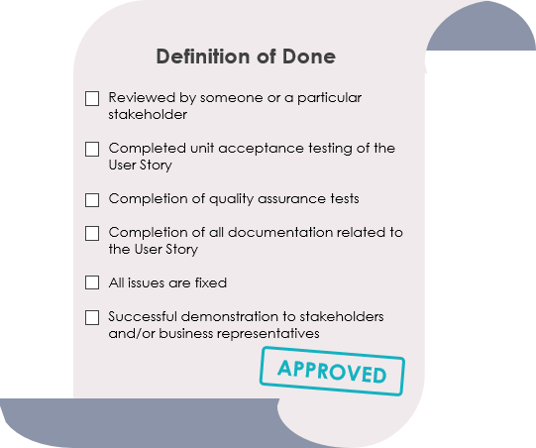
Product Increment
Definition of Done
Every Product Backlog item has acceptance criteria that define measurably what must be met when the item is declared to be done.
The Definition of Done is a shared understanding of the Scrum Team on the meaning of work to be complete. It typically contains quality criteria, constraints and overall non-functional requirements.

Slide 37
Activity

Slide 38
Activity: Product Artifacts
Title: "Streamlining Healthcare: Optimizing Scrum Artifacts for a Medical Clinic"
Introduction: In this case study, your students will delve into the healthcare sector by examining the challenges faced by "HealthyCare Clinic," a busy medical clinic. As a university teacher, you can present this case to your students to help them understand how Scrum artifacts play a crucial role in organizing work, ensuring transparency, and delivering value in a non-software context.
Background: HealthyCare Clinic provides a range of medical services to the community. Due to increasing patient volumes and a need for improved organization, the clinic's management has decided to adopt Scrum practices to enhance its operations.
Scrum Artifacts at HealthyCare Clinic:
Product Backlog: A dynamic list of patient services and improvements that need to be addressed. It is prioritized by the clinic manager based on patient needs and clinic goals.
Sprint Backlog: A subset of items from the Product Backlog that the clinic team commits to completing during a Sprint (two weeks). This includes medical procedures, process improvements, and patient engagement initiatives.
Increment: At the end of each Sprint, the clinic delivers an "increment" – the sum of completed work that is potentially releasable. This could be new patient services, improved processes, or patient education materials.
Definition of Done (DoD): A clear and shared understanding of what it means for work to be considered complete. For the clinic, this could include accurate medical records, patient feedback surveys, and proper billing procedures.

Slide 39
Activity: Product Artifacts
Challenges Faced:
Unclear Prioritization: The Product Backlog is continuously growing, and the clinic manager struggles to prioritize items effectively based on patient needs and business goals.
Incomplete Sprints: Due to frequent emergencies and disruptions, the clinic team often fails to complete the committed work during a Sprint.
Undefined Increment: The clinic finds it challenging to determine what constitutes a meaningful "increment" in a non-software context, as their work involves a combination of services, processes, and patient interactions.
Vague Definition of Done: There's confusion among clinic staff about what steps are necessary to consider a patient service or process improvement as "done."
Lack of Transparency: Patients are unaware of upcoming services or improvements, resulting in dissatisfaction and underutilization of the clinic's offerings.

Slide 40
Activity: Product Artifacts
Discussion Questions:
How can HealthyCare Clinic's management streamline the process of prioritizing items in the Product Backlog to ensure that patient needs and clinic goals are aligned?
Suggest strategies that the clinic team can employ to minimize disruptions and emergencies during a Sprint, allowing them to complete the committed work.
Define what an "increment" would look like for HealthyCare Clinic. How can they measure progress and communicate the value delivered to patients and staff?
Explain the importance of a well-defined Definition of Done for the clinic's services and processes. Provide examples of criteria that could be included in their DoD.
Recommend methods for HealthyCare Clinic to enhance transparency regarding their services and improvements to both existing and potential patients.

Slide 41
Scrum Events

Slide 42
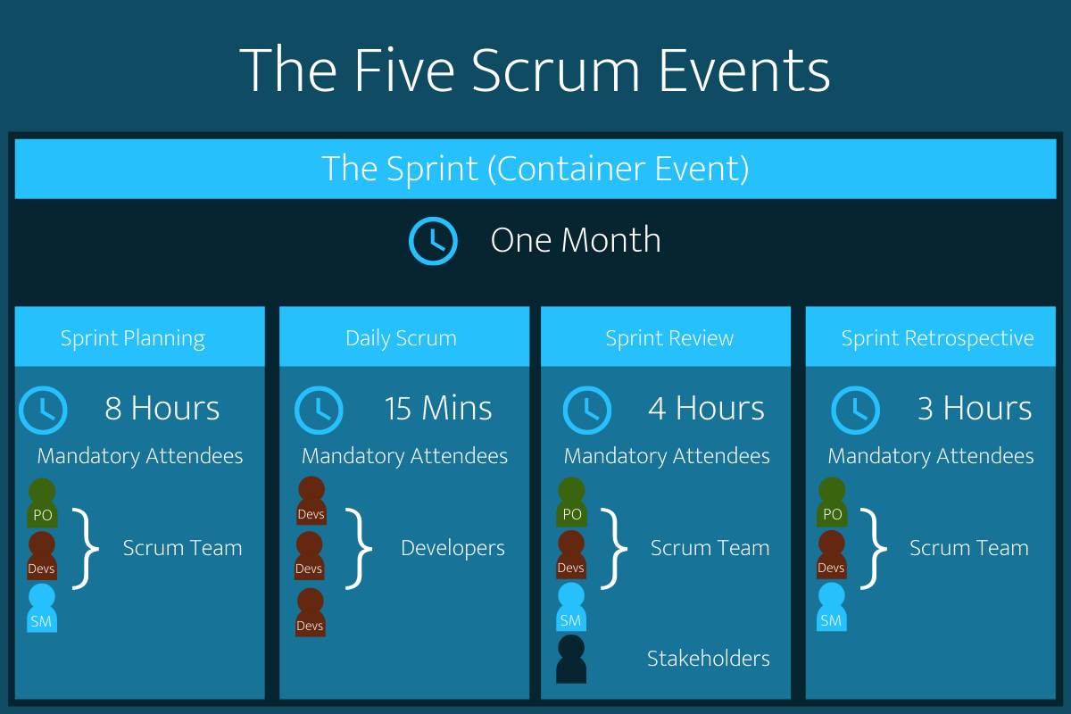
Scrum Events

Slide 43
Scrum Meetings
Event | Inspection | Adaption | Who Attends | Time-Box for 1 Month
Sprint Planning | Product Backlog | Sprint Goal, Forecast, Sprint Backlog | Scrum Team | 8 hours
Daily Scrum | Progress Toward Sprint Goal | Sprint Backlog | Development Team | 15 Minutes (Always)
Sprint Review | Increment, Sprint, Product Backlog | Product Backlog | Scrum Team, Stakeholders | 4 Hours
Sprint Retrospective | Sprint | Actionable & Committed Improvements | Scrum Team | 3 Hours

Slide 44
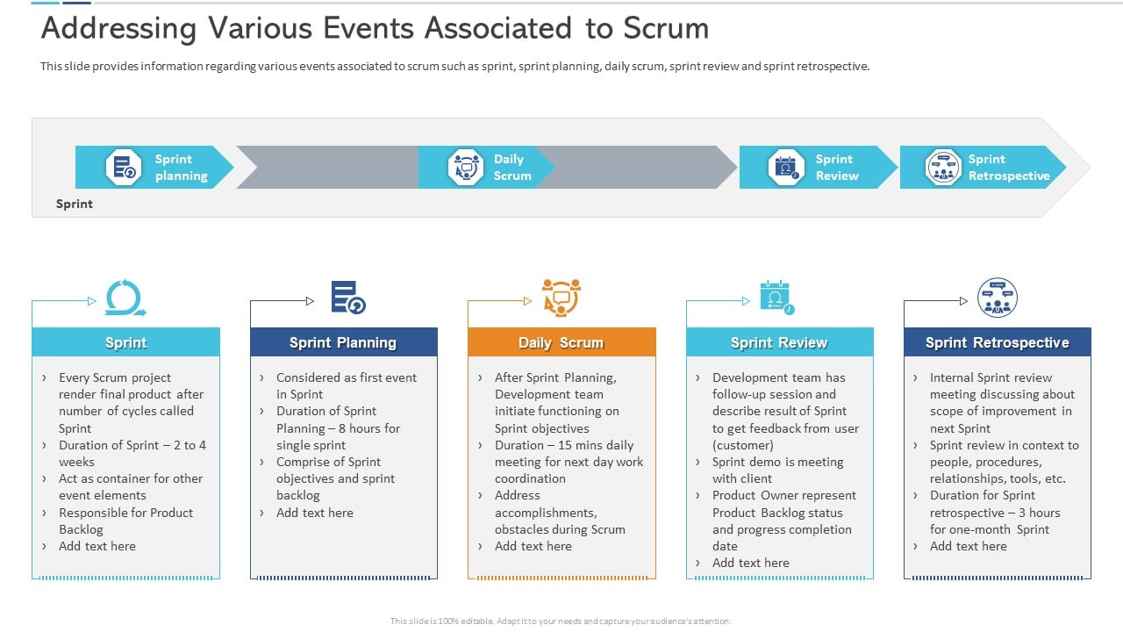

Scrum Events
Sprint
Sprint
Planning
Daily
Scrum
Sprint
Review
Sprint Retrospective
Every Scrum project render final product after number of cycles called Sprint
Duration of Sprint – 2 to 4 weeks
Act as container for other event elements
Responsible for Product Backlog
Considered as first event in Sprint
Duration of Sprint Planning – 8 hours for single sprint
Comprise of Sprint objectives and sprint backlog
After Sprint Planning, Development team initiate functioning on Sprint objectives
Duration - 15 mins daily meeting for next day work coordination
Address accomplishments, obstacles during Scrum
Development team has follow-up session and describe result of Sprint to get feedback from user(customer)
Sprint demo is meeting with client
Product Owner represent Product Backlog status and progress completion date
Internal Sprint review meeting discussing about scope of improvement in next Sprint
Sprint review in context to people, procedures, relationships, tools, etc.
Duration for Sprint retrospective – 3 hours for one-month Sprint

Slide 45
Activity

Slide 46
Activity: Scrum Meetings
Title: "Revamping E-Commerce: Applying Scrum Events for Project Success“
Introduction: In this case study, we'll dive into the world of e-commerce with a focus on a company called "DigitalMart." As a university teacher, your students will have the opportunity to analyze DigitalMart's challenges and apply Scrum events to devise effective solutions. Through this exercise, students will learn how Scrum events can drive collaboration, transparency, and continuous improvement in a dynamic business environment.
Background: DigitalMart is an online marketplace that connects buyers and sellers. Due to the rapidly changing e-commerce landscape, the company recognizes the need for agility to stay competitive. They have decided to implement the Scrum framework to enhance their product development process.
Scrum Events at DigitalMart:
Sprint Planning: The team meets to determine the work that will be completed in the upcoming Sprint. The Product Owner presents the top items from the Product Backlog, and the Development Team collaborates to create a Sprint Goal and select items they commit to completing.
Daily Scrum (Daily Standup): A 15-minute daily meeting for the Development Team to synchronize their work. Each team member answers three questions: What did I complete yesterday? What will I work on today? Are there any obstacles in my way?
Sprint Review: At the end of each Sprint, the team presents the work they've completed to stakeholders, including a demonstration of the product increment. Feedback is gathered to inform the next Sprint.
Sprint Retrospective: After the Sprint Review and before the next Sprint Planning, the team reflects on their performance and identifies improvement opportunities. The Scrum Master facilitates this meeting to foster continuous improvement.

Slide 47
Activity: Scrum Meetings
Challenges Faced:
Scope Creep: During Sprints, new feature requests frequently emerge from stakeholders, causing the team to struggle with maintaining the Sprint Goal.
Lack of Transparency: The Development Team is working in isolation, and stakeholders have minimal insight into their progress until the end of the Sprint.
Ineffective Daily Scrums: Daily Standup meetings are becoming lengthy and veering off track, leading to disengagement among team members.
Limited Stakeholder Involvement: Stakeholders are only engaged during Sprint Review, resulting in delayed feedback and missed opportunities for alignment.
Stagnation in Improvement: Sprint Retrospectives are not resulting in actionable improvements, and the team is unsure how to address the identified issues.
Discussion Questions:
How can DigitalMart's Development Team better handle scope creep during a Sprint while still remaining focused on the Sprint Goal?
What strategies can the Scrum Master employ to enhance transparency in the development process and keep stakeholders informed?
Suggest techniques that the Development Team can implement to make their Daily Scrum meetings more efficient and effective.
How can DigitalMart involve stakeholders more consistently throughout the Sprint, rather than just during the Sprint Review?
Provide recommendations for the Scrum Master to revitalize the Sprint Retrospective, ensuring that identified improvements are acted upon.

Slide 48
Scrum Principles

Slide 49
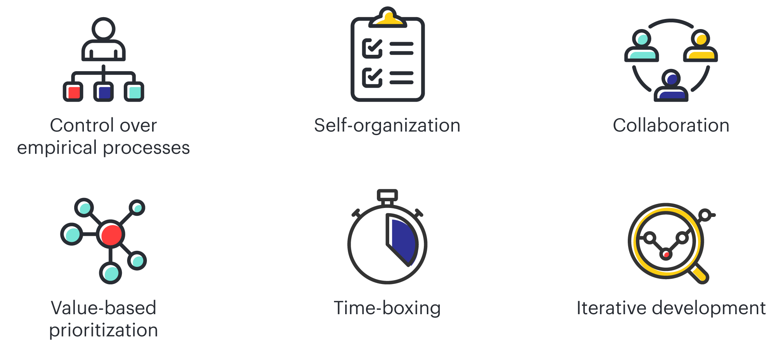
Key Scrum Principles

Slide 50
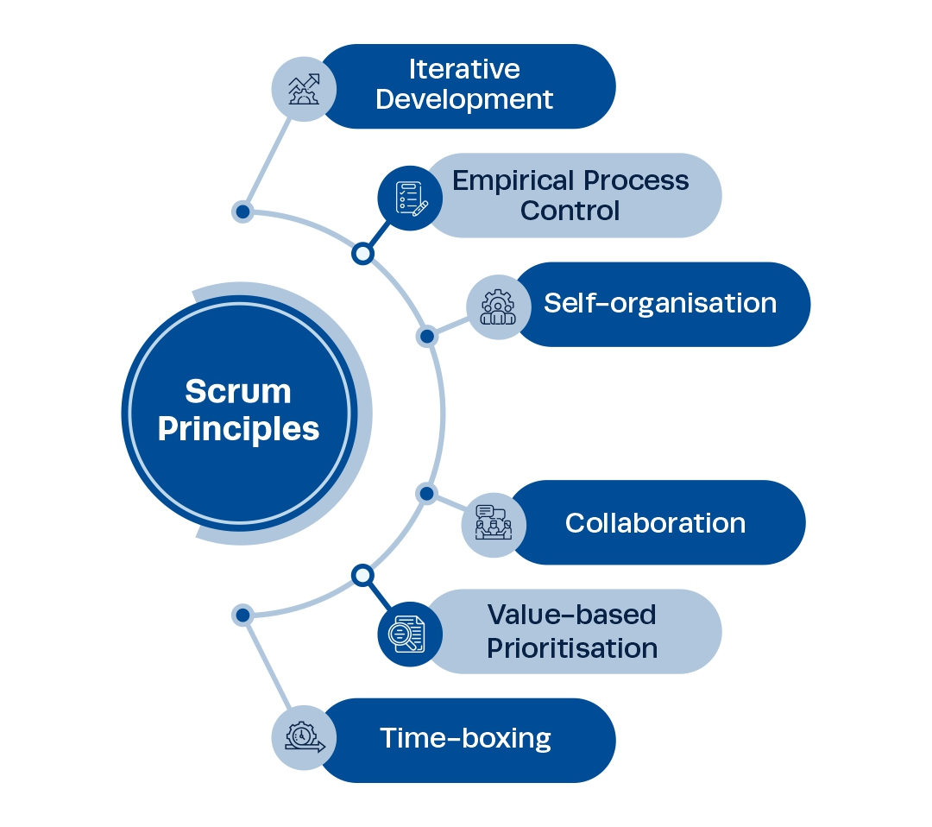
Key Scrum Principles
This principle emphasizes the core philosophy of Scrum based on the three main ideas of transparency, inspection, and adaptation. Empirical process control aids learning through experimentation, especially when the problem is not well defined or when there are no clear solutions.
This principle defines iterative development and emphasizes how to better manage changes and build products that satisfy customer needs. It also describes the Product Owner’s and organization’s responsibilities related to iterative development.
This principle focuses on today’s workers, who deliver significantly greater value when self-organized, resulting in better team buy-in and shared ownership; and an innovative and creative environment which is more conducive for growth.
This principle focuses on the awareness, articulation, and appropriation. It also advocates project delivery as a shared value-creation process with teams working and interacting together with the customer and other business stakeholders, to deliver the greatest value.
This principle highlights the focus of Scrum to deliver maximum business value, from early in the project and continuing throughout.
This principle describes how time is considered a limiting constraint in Scrum and used to help effectively manage project planning and execution. Time-boxed elements in Scrum include all the scrum events/meetings.

Slide 51
Scrum Principles Examples
Scrum Principles | Examples
Empirical Process Control | At the end of each sprint, the team reflects on their performance, gathers feedback, and adjusts their approach for the next sprint based on actual progress and learning.
Self-Organization | During sprint planning, the development team collaboratively decides how to tackle backlog items, assigns tasks, and estimates effort without being micromanaged.
Collaboration | Developers, designers, and testers collaborate throughout the sprint to ensure that user stories are fully implemented, tested, and meet the acceptance criteria.
Value-Based Prioritization | The Product Owner prioritizes implementing a secure payment gateway over adding an optional customization feature due to its higher value to the users.
Time-Boxing | Daily standup meetings have a time-box of 15 minutes to keep them focused and efficient while providing a daily opportunity for synchronization.
Iterative Development | In a two-week sprint, the team develops a subset of features, tests them, and integrates them to produce a product increment that could be delivered if necessary.

Slide 52
Activity

Slide 53
Activity: Scrum Principles
Title: "Revolutionizing Retail: Applying Scrum Principles in a Fashion Brand“
Introduction: In this case study, your students will have the opportunity to explore the retail industry through the lens of a fashion brand named "StyleSync." As a university teacher, you can present this case to your students to help them grasp the core principles of Scrum and understand how they can be applied beyond software development, fostering agility and innovation.
Background: StyleSync is a well-known fashion brand that produces trendy clothing and accessories. Due to the rapidly changing fashion landscape and customer demands, the company is looking to embrace agility and has chosen to implement Scrum principles to enhance their operations.
Scrum Principles at StyleSync:
Empirical Process Control: StyleSync recognizes the unpredictable nature of fashion trends and acknowledges that their assumptions may change. They embrace transparency, inspection, and adaptation to make informed decisions.
Self-Organizing Teams: Cross-functional teams at StyleSync are empowered to make decisions, collaborate, and determine how to best achieve their Sprint goals. They value diversity of skills and expertise.
Collaboration: Various departments, including design, manufacturing, marketing, and sales, collaborate closely to bring a fashion collection from concept to customer. They value open communication and regular interactions.
Iterative Development: StyleSync breaks down their product development into Sprints, allowing them to frequently release new collections and adapt to emerging trends.

Slide 54
Activity: Scrum Principles
Challenges Faced:
Rapidly Changing Trends: The fashion industry experiences swift changes in customer preferences and trends. StyleSync struggles to balance long-term planning with the need for flexibility.
Coordination Across Teams: Different teams have their own priorities and timelines. This leads to misalignment and delays in launching collections.
Unpredictable Customer Behavior: StyleSync finds it challenging to forecast customer demand accurately, resulting in either overstocking or understocking of certain items.
Lack of Transparency: Some teams have a limited understanding of the work other teams are doing, resulting in missed opportunities for cross-functional collaboration.
Discussion Questions:
How can StyleSync apply empirical process control to their fashion design and production process to better adapt to changing trends while maintaining transparency?
Describe how self-organizing teams can help StyleSync streamline their operations, improve decision-making, and foster innovation in their collections.
Provide strategies for improving collaboration among design, manufacturing, marketing, and sales teams to ensure smoother collection launches.
How can StyleSync use iterative development to their advantage in the fashion industry? What benefits can they gain from releasing collections in Sprints?
Propose methods for StyleSync to gain insights into customer behavior and preferences, allowing them to better plan their collections and stock levels.

Slide 55
KANBAN
Kanban is a popular framework used to implement agile and DevOps software development.

Slide 56
History of Kanban
Kanban (Japanese: カンバン and Chinese: 看板, meaning signboard or billboard) is a scheduling system for lean manufacturing (also called just-in-time manufacturing, abbreviated JIT).
Taiichi Ohno, an industrial engineer at Toyota, developed kanban to improve manufacturing efficiency.
The system takes its name from the cards that track production within a factory.
Kanban is also known as the Toyota nameplate system in the automotive industry.
The present state of Kanban can trace its roots to the Toyota Production System (and its antecedents) and the work of people like Taiichi Ohno and W. Edwards Deming.
The collective set of practices for knowledge work that is now commonly referred to as Kanban mostly originated on a team at Corbis in 2006.
Those practices quickly spread to encompass a large and diverse international community that has continued to enhance and evolve the approach.

Slide 57
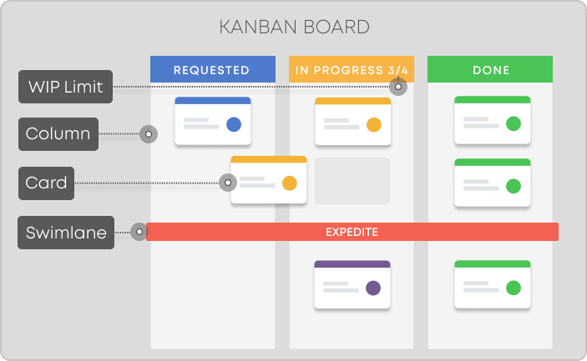

Slide 58
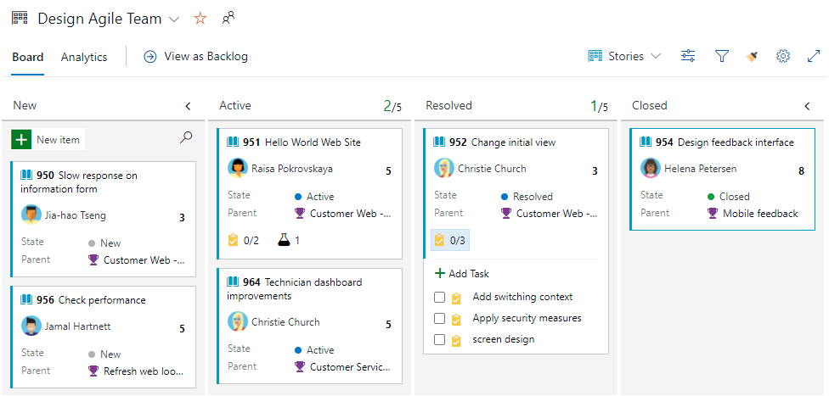

Slide 59
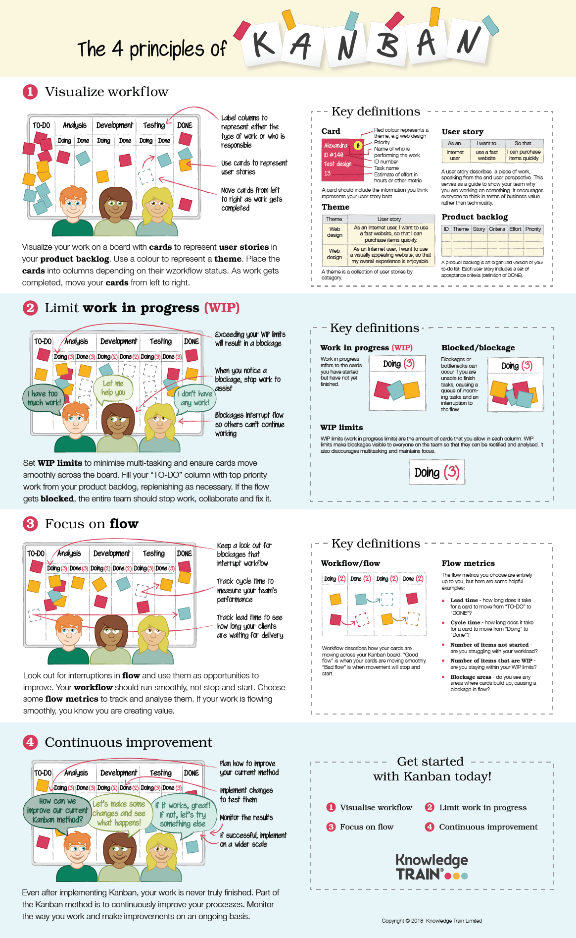

Slide 63
Kanban Values
Kanban Values
Transparency
Share Information
Clear Vocabulary
Balance
Capacity vs demand
Different view points
Collaboration
Work together
Customer focus
Goals
Actual product/service
Flow
Work is continuous
Leadership
Example at all levels
Understanding
Know yourself
Know the organization
Agreement
Move together
Respect
Value people

Slide 64
Kanban Agendas and Values
Agendas | Values
Sustainability | Transparency
 | Balance
 | Collaboration
Service Orientation | Customer Focus
 | Flow
 | Leadership
Survivability | Understanding
 | Agreement
 | Respect

Slide 65
Kanban Metrics
Metrics | Explanation
Work in Progress (WIP) | The number of work items started but not finished.
Cycle Time | The amount of elapsed time between when a work item starts and when a work item finishes
Work Item Age | The amount of time between when a work item started and the current time. This applies only to items that are still in progress.
Throughput | The number of work items finished per unit of time.

Slide 66
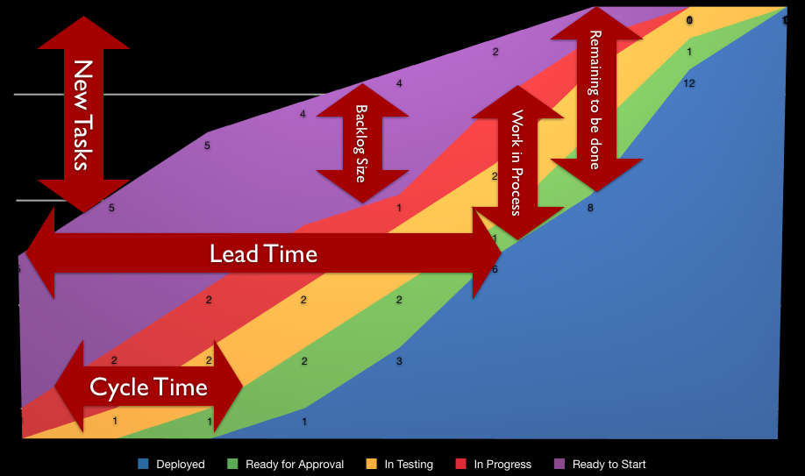
Kanban Metrics

Slide 67
Activity

Slide 68
Kanban Metrics
Question 1: Work in Progress (WIP)
On a Kanban board, a team has a WIP limit of 5 for the "In Progress" column. At a specific point in time, there are 4 work items actively being worked on. Is the team within its WIP limit?
Question 2: Cycle Time
A software development team starts work on a user story on Day 1. The user story is marked as "Done" on Day 5. What is the cycle time for this user story?
Question 3: Work Item Age
Given a Kanban board with the following timestamps for a work item: Created on Day 1, moved to "In Progress" on Day 2, and marked as "Done" on Day 6. What is the work item's age when it is marked as "Done"?
Question 4: Throughput
In a Kanban system, a team completes 15 user stories in a week. What is the weekly throughput of the team?
Question 5: Calculating Average Cycle Time
A team measures cycle time for 5 user stories: 6 days, 8 days, 4 days, 10 days, and 7 days. What is the average cycle time for these user stories?

Slide 69
Kanban Metrics
Question 6: Impact of WIP Limit Changes
A team has a WIP limit of 5 for a specific column on their Kanban board. They decide to reduce the WIP limit to 3. What could be the potential impact on cycle time and throughput?
Question 7: Analyzing Cumulative Flow Diagram (CFD)
Consider a Cumulative Flow Diagram (CFD) that shows the following data: Day 1 - 4 items in "To Do," Day 5 - 2 items in "To Do," 3 items in "In Progress," and 1 item in "Done." What is the average cycle time for the items that were marked as "Done"?
Question 8: Monitoring Work Item Age
A work item is currently in the "In Progress" column for 2 days. Prior to that, it spent 3 daays in the "To Do" column. Calculate the total age of the work item.
Question 9: Evaluating Throughput and WIP
In a Kanban system, if the team completes 8 work items in a week and the average WIP during that week was 6, what was the average cycle time for the completed work items?

Slide 70
Any Question?
End!

